Slide 1

Introduction of Nodejs

Slide 2
Content
Introduction about nodejs
Non-blocking and asynchronous
Basic build-in package
Npm
Node in everywhere
Frontend
BackEnd
Application (mobile + desktop)
Simple Node-Express server

Slide 3
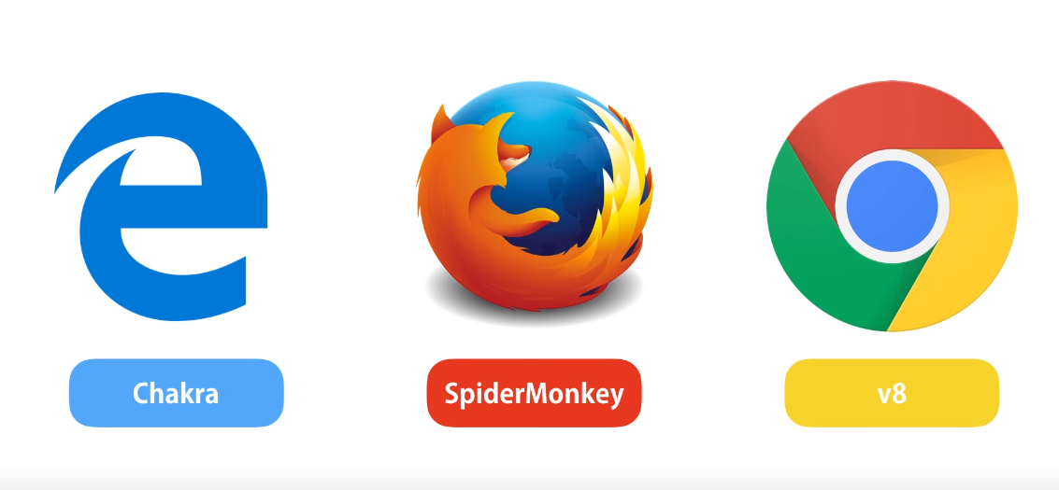
Nodejs
Browser
JS Engine
Machine Code
Javascript

Slide 4

Nodejs
Node
Machine Code
Javascript
V8
https://nodejs.org/en/

Slide 5
Nodejs
Asynchronous event driven JavaScript runtime.
That executes JavaScript code outside of a browser
Code demo: https://github.com/LeTranAnhVu/todoapp-express-api/blob/master/demo/demo-async.js

Slide 6
Nodejs
Blocking
Non-blocking
Kitchen
Kitchen
Table 1
Table 2
Table 3
Table 1
Table 2
Table 3
Code demo: https://github.com/LeTranAnhVu/todoapp-express-api/blob/master/demo/demo-async.js

Slide 7
Npm
NPM : Node Package Manager
The largest ecosystem of open source libraries in the world

Slide 8
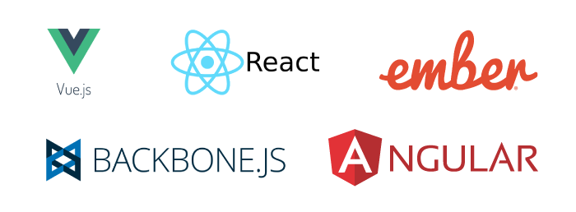
Playground
Frontend:

Slide 9






Playground
Backend:

Slide 10

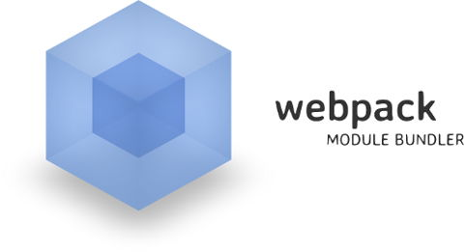
Playground
Task runner:

Slide 11


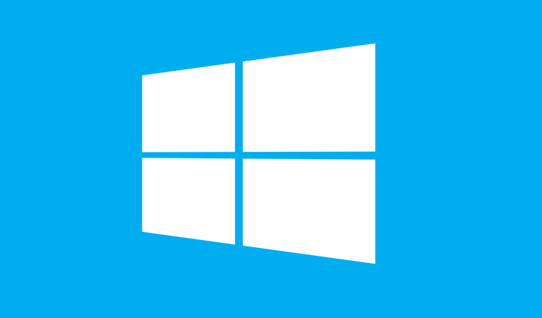








Playground
Desktop application:
HTML
CSS
Javascript

Slide 12
Demo Simple Express Server
Feature:
Provide the Api
Express, build-in module in nodejs.
Read/ write json file
No need using any Database
Deploy in heroku
Usage:
Do simple demo frontend app: Angular, React or Vue
Github resource:
https://github.com/LeTranAnhVu/todoapp-express-api

Slide 13
Demo Simple Express Server
Restful API:
Url | HTTP Method | Body | Description
/api/v1/todos?page=&search= | GET | empty | Show list of todos
/api/v1/todos | POST | Todo json | Create new todo
/api/v1/todos | DELETE | Array of todo ids json | Delete todos
/api/v1/todos/:id | GET | empty | Show a todo
/api/v1/todos/:id | PUT | Todo json | Update a todo
/api/v1/todos/:id | DELETE | empty | Delete a todo

Slide 14
Demo Simple Express Server
Express JS-middleware:
Client request
Middleware
Revolve the request
App.use (function ( req, res, next) {
// do something before
})
App.METHOD => handle request
Request something

Slide 15
Demo Simple Express Server
Express JS-middleware:
General Middleware
Specific Middleware
App.use (function ( req, res, next) {
// do something before
})
// this middleware use for all route and methods
Function mAuth () {
// check Authentication
}
App.get(‘admin’, mAuth, (req, res, next){
// return admin dashboard
})

Slide 16
Demo Simple Express Server
Express JS-middleware:
Error handling Middleware (4 parameters)
app.use ((err, req, res, next) => { if (err) { res.status(err.status).json(err) } })

Slide 17
References:
How Nodejs Work: https://www.youtube.com/watch?v=jOupHNvDIq8
Undertanding non-blocking: https://www.youtube.com/watch?v=8aGhZQkoFbQ?t=760
Electron Application: https://brainhub.eu/blog/electron-framework-example-apps/
How Nodejs middleware work: https://medium.com/@selvaganesh93/how-node-js-middleware-works-d8e02a936113
Github resource: https://github.com/LeTranAnhVu/todoapp-express-api

Slide 18
Thank you for your listening
Q&A

